Slide 1



SRM INSTITUTE OF SCIENCE AND TECHNOLOGY
18CSC201J – Data Structures and Algorithms
Unit III- STACK & QUEUE

Slide 2
SESSION 11

Slide 3
Circular Queue

Slide 4
Definition
Circular Queue is a linear data structure in which first position of the queue is connected with last position of the queue.
In other words, The queue is considered as a circular queue when the positions 0 and MAX-1 are adjacent.
It is also referred as RING BUFFER.

Slide 5
Principle Used
FIFO (First In First Out) is used for performing operation.

Slide 6
Operations Involved
Enqueue
Dequeue

Slide 7
Variables Used
MAX- Number of entries in the array
Front – is the index of front queue entry in an array (Get the front item from queue)
Rear – is the index of rear queue entry in an array.(Get the last item from queue)

Slide 8
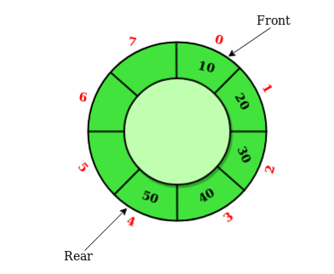
Concepts of Circular Queue

Slide 9
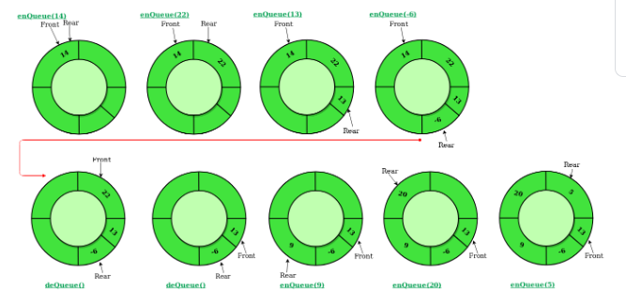
Illustration of Enqueue and Dequeue

Slide 10
Conditions used in Circular Queue
Front must point to the first element.
The queue will be empty if Front = Rear.
When a new element is added the queue is incremented by value one(Rear = Rear + 1).
When an element is deleted from the queue the front is incremented by one (Front = Front + 1).

Slide 11
Steps Involved in Enqueue
Check whether queue is Full or not by using the following condition
((rear == SIZE-1 && front == 0) || (rear == front-1))
If queue is full, display the queue is full else we can insert an element by incrementing rear pointer.

Slide 12
Steps Involved in Dequeue
1. Check whether queue is Empty or not by using the following condition
if(front==-1).
2. If it is empty then display Queue is empty, else we can delete the element.

Slide 13
Difference between Queue and Circular Queue
In a normal Queue, we can insert elements until queue becomes full. But once queue becomes full, we can not insert the next element even if there is a space in front of queue.
The unused memory locations in the case of ordinary queues can be utilized in circular queues.

